Slide 1
LOGISTICS
PROJECT

Slide 2
PROJECT VISION & OBJECTIVE
  IN TODAY'S COMPETITIVE E-COMMERCE LANDSCAPE, OPTIMIZING LOGISTICS AND UNDERSTANDING SALES PERFORMANCE ARE CRITICAL FOR PROFITABILITY AND CUSTOMER SATISFACTION.
  THIS PROJECT AIMS TO BUILD A SCALABLE, DATA-DRIVEN ANALYTICS PLATFORM THAT TRANSFORMS RAW ORDER AND LOGISTICS DATA INTO ACTIONABLE BUSINESS INTELLIGENCE.

Slide 3
THE BUSINESS PROBLEM
  UNPREDICTABLE DELIVERIES: INCONSISTENT DELIVERY TIMES ARE LEADING TO CUSTOMER DISSATISFACTION.
  Rising Operational Costs: Understanding the relationship between shipping costs and product revenue is unclear.
  Warehouse Inefficiency: It's difficult to pinpoint which warehouses are underperforming and why.
  Lack of PRODUCT INSIGHT: THE COMPANY DOESN'T KNOW WHICH SPECIFIC PRODUCTS ARE MOST FREQUENTLY ASSOCIATED WITH DELAYS, HINDERING INVENTORY AND SUPPLIER MANAGEMENT.

Slide 4




TECHNICAL ARCHITECTURE & IMPLEMENTATION
ETL PIPLINE

Slide 5
KEY FEATURES & ANALYSES DELIVERED
  WAREHOUSE EFFICIENCY DASHBOARD:
    Late Delivery Rate per Warehouse.
    Average Delivery Time Delta (Estimated vs. Actual).
  Financial PERFORMANCE REPORT:
    REVENUE VS. SHIPPING COST RATIO PER WAREHOUSE.
    AGGREGATE REVENUE AND COST SUMMARIES.
  PRODUCT DELAY ANALYSIS:
    A RANKED LIST OF THE TOP 10 PRODUCTS WITH THE HIGHEST CONTRIBUTION TO LATE DELIVERIES.
    PRODUCT-LEVEL BREAKDOWN OF AVERAGE DELAY DAYS.
  ORDER-LEVEL SUMMARY:
    COMPREHENSIVE VIEW OF ORDER VALUE, SHIPPING COST, AND DELIVERY STATUS.

Slide 6



RESULTS AND INSIGHTS
Reduce Costs
Improve Customer Satisfaction
Enhance Operational Efficiency

Slide 7
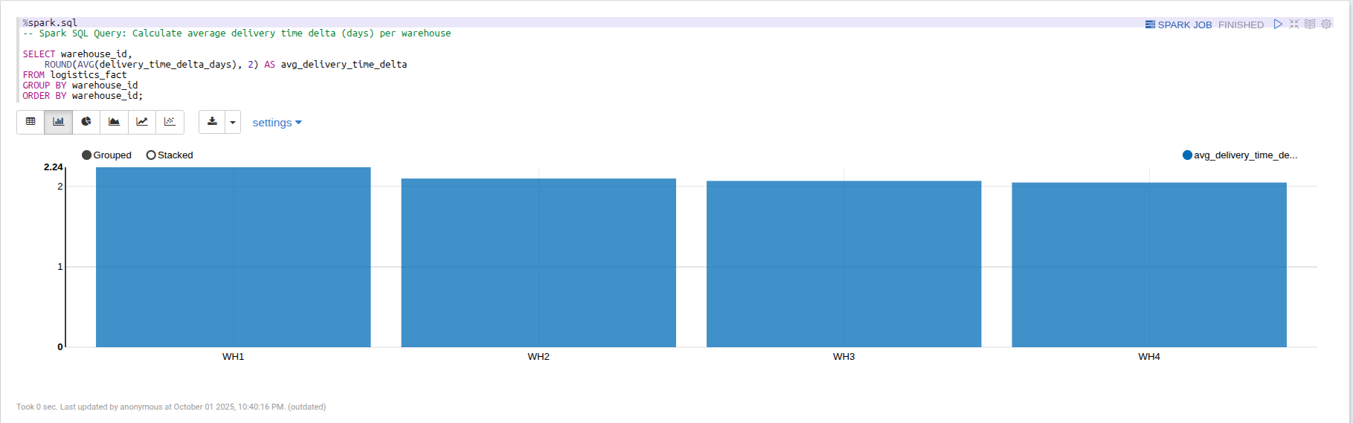
INSIGHTS USING SPARK SQL
AVERAGE DELIVERY TIME DELTA PER WAREHOUSE

Slide 8
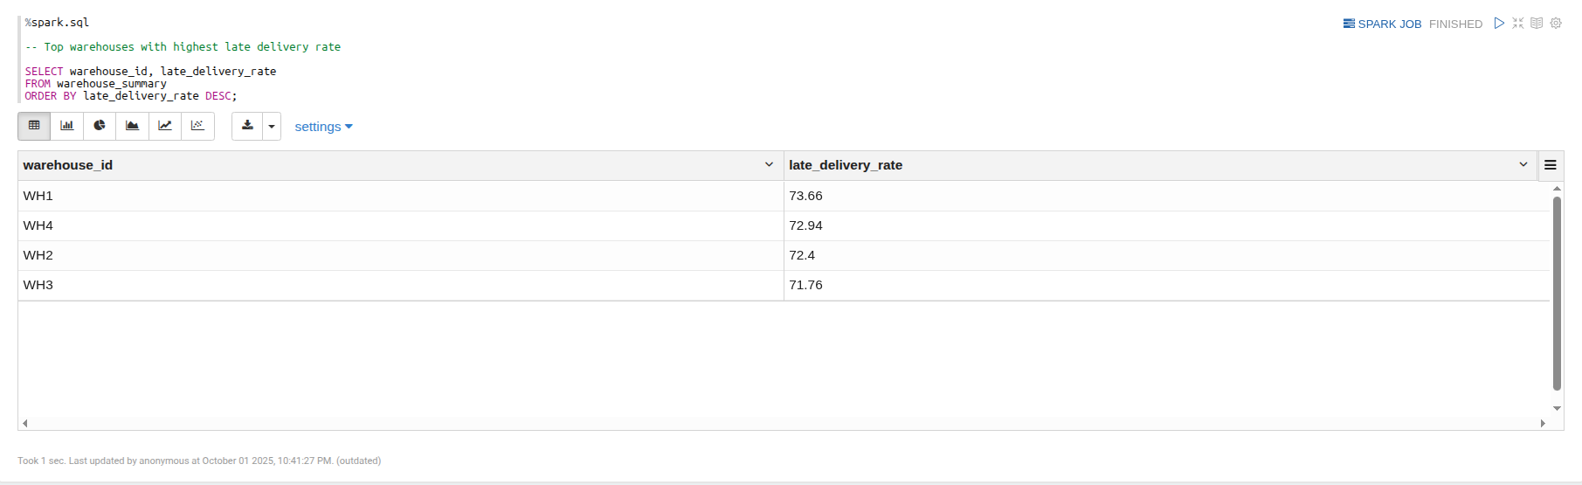
INSIGHTS USING SPARK SQL
TOP WAREHOUSES WITH HIGHEST LATE DELIVERY RATE

Slide 9
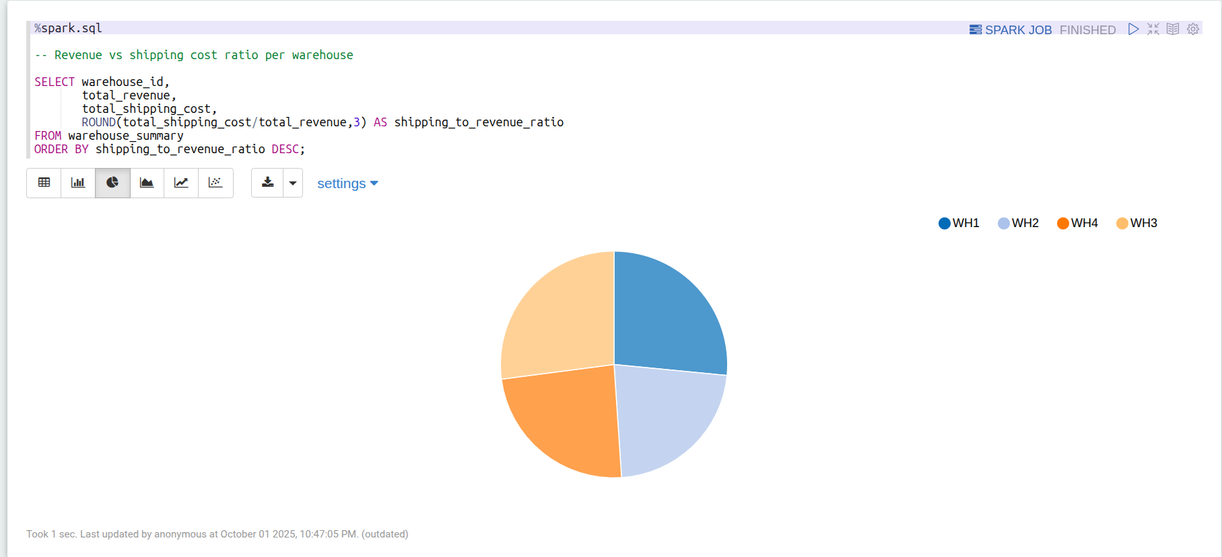
INSIGHTS USING SPARK SQL
REVENUE VS SHIPPING COST RATIO PER WAREHOUSE

Slide 10
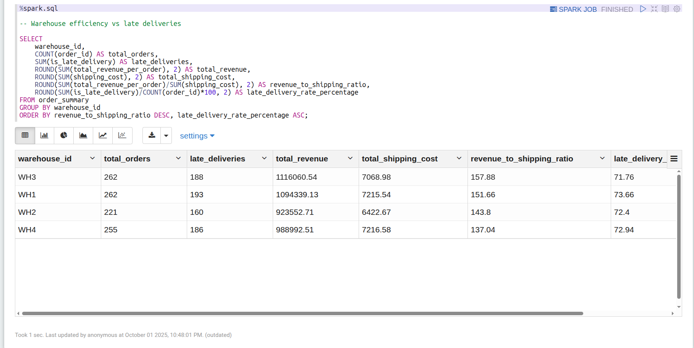
INSIGHTS USING SPARK SQL
WAREHOUSE EFFICIENCY VS LATE DELIVERIES

Slide 11
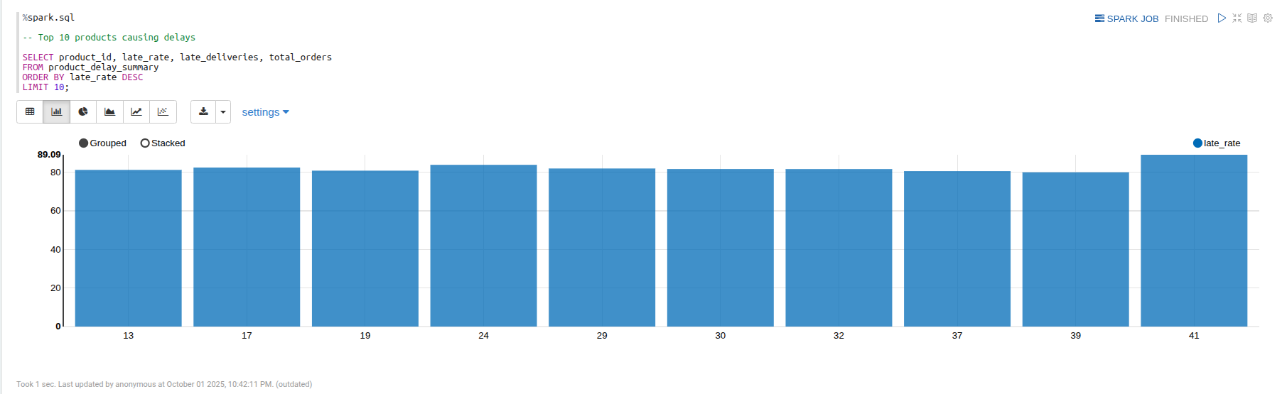
INSIGHTS USING SPARK SQL
TOP 10 PRODUCTS CAUSING DELAYS

Slide 12
CONCLUSION
THIS PROJECT DEMONSTRATES THE POWER OF BIG DATA TECHNOLOGIES TO SOLVE REAL-WORLD BUSINESS PROBLEMS.
BY BUILDING A SCALABLE ANALYTICS PIPELINE WITH SQOOP , SPARK AND HIVE
WE HAVE PROVIDED A CLEAR, QUANTIFIABLE VIEW OF THE COMPANY'S LOGISTICS AND SALES OPERATIONS,
LAYING THE FOUNDATION FOR CONTINUOUS IMPROVEMENT AND A SIGNIFICANT COMPETITIVE ADVANTAGE.

Slide 13


THANK
YOU!

